Slide 1
NexGenBank

Slide 2
Table of contents
1
Our Team
2
About the project
3
Used Technologies​

Slide 3
1
Our Team

Slide 4

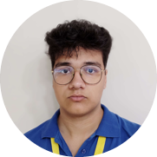
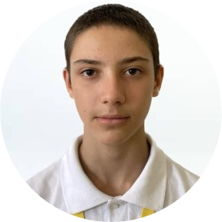

Plamen Petkov
Dimitar Dimitrakov
Boris Milev
Dimitar Kostadinov
Designer
Front-end Developer
Back-end Developer
Scrum Trainer

Slide 5
2
About the project

Slide 6

NexGenBank is a collaborative project developed by a passionate team of software engineers and financial experts. Our mission is to revolutionize the banking experience by leveraging the latest technologies to provide secure, efficient, and user-friendly financial services.

Slide 7
3
Used Technologies​

Slide 8






Slide 9
Now let’s check out
NexGenBank !

